Slide 1
Spring Security

Slide 2
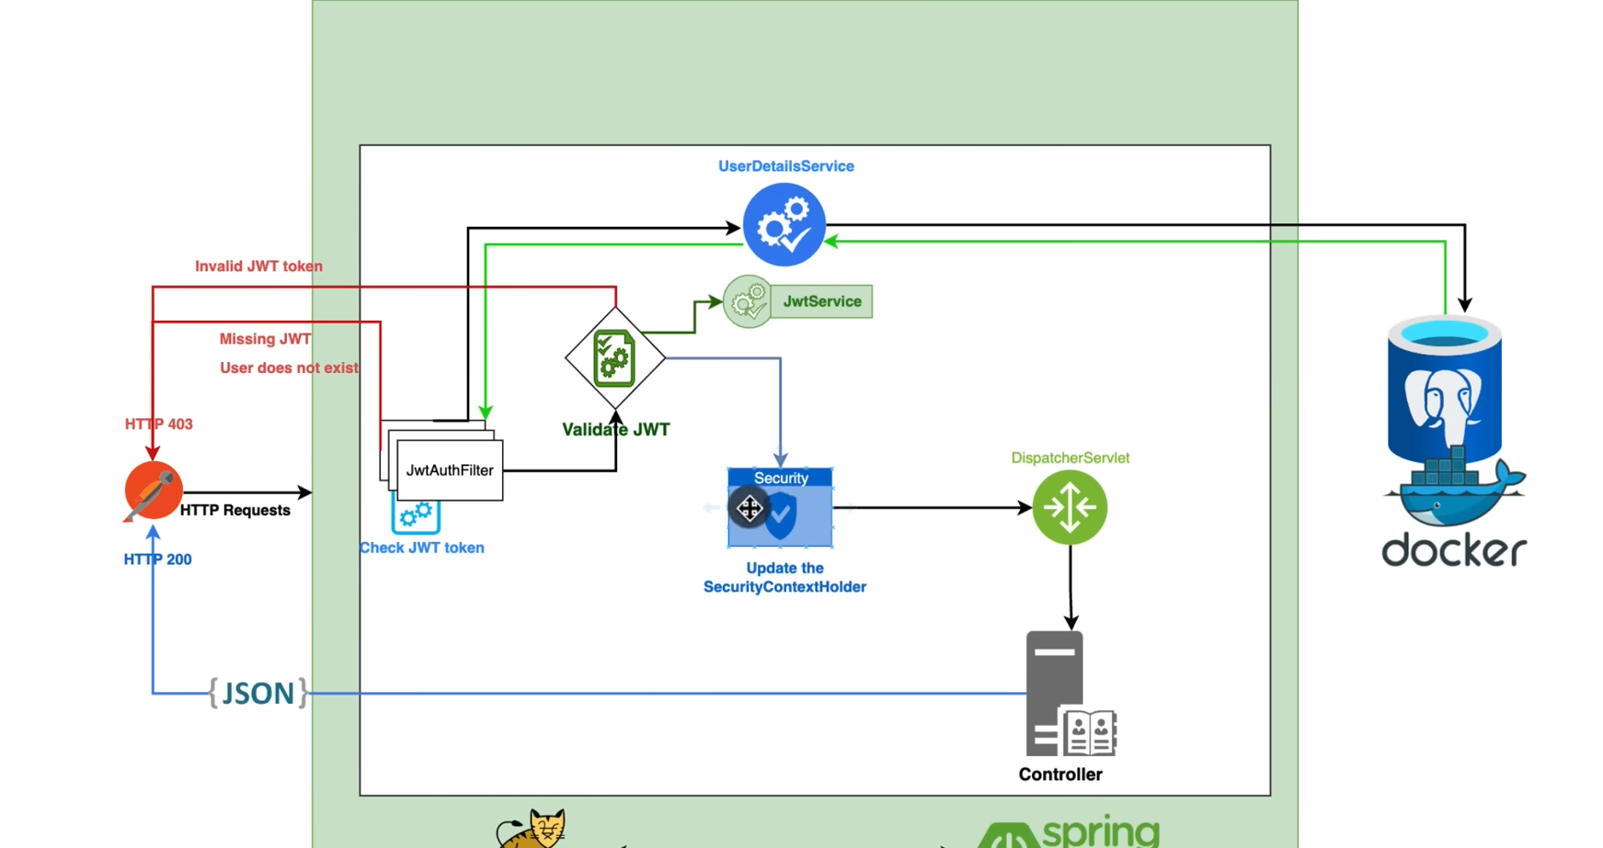

Slide 3
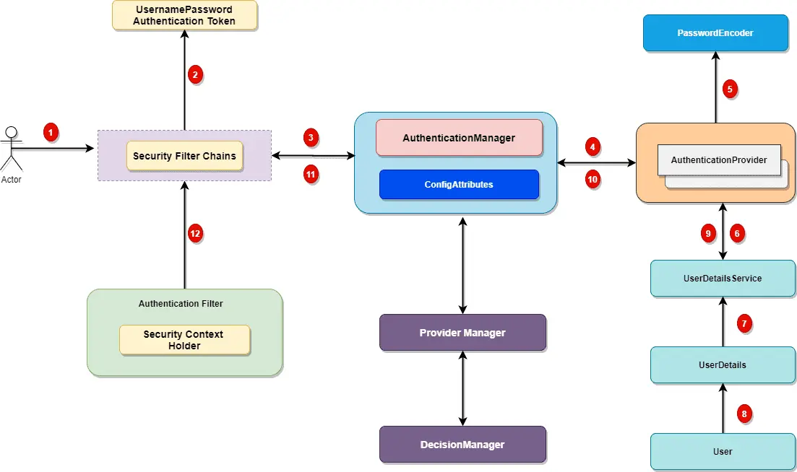

Slide 4
SecurityContextHolder
The SecurityContext is used to store the details of the currently authenticated user, also known as a principle. So, if you have to get the username or any other user details, you need to get this SecurityContext first. The SecurityContextHolder is a helper class, which provides access to the security context.
In order to get the current username, you first need a SecurityContext, which is obtained from SecurityContextHolder. This SecurityContext keep the user details in an Authentication object, which can be obtained by calling the getAuthentication() method.

Slide 5
SecurityContextHolder
Once you got the Authentication object, you can either cast it into UserDetails or use it as it is. The UserDetails object is the one Spring Security uses to keep user-related information.
bject principal = SecurityContextHolder.getContext()
.getAuthentication()
.getPrincipal();
if (principal instanceof UserDetails) {
String username = ((UserDetails)principal).getUsername();
} else {
String username = principal.toString();
}

Slide 6
UserDetailsService
The UserDetailsService is a core interface in Spring Security framework, which is used to retrieve the user’s authentication and authorization information.
This interface has only one method named loadUserByUsername() which we can implement to feed the customer information to the Spring security API. The DaoAuthenticationProvider will use this information to load the user information during authentication process. Here is the definition of the interface.
UserDetailsService is used by DaoAuthenticationProvider for retrieving a username, a password, and other attributes for authenticating with a username and password. Spring Security provides in-memory and JDBC implementations of UserDetailsService

Slide 7
UserDetailsService
UserDetailsService interface has a method to load User by username and returns a UserDetails object that Spring Security can use for authentication and validation.
UserDetails contains necessary information (such as: username, password, authorities) to build an Authentication object.
UsernamePasswordAuthenticationToken gets {username, password} from login Request, AuthenticationManager will use it to authenticate a login account.
AuthenticationManager has a DaoAuthenticationProvider (with help of UserDetailsService & PasswordEncoder) to validate UsernamePasswordAuthenticationToken object. If successful, AuthenticationManager returns a fully populated Authentication object (including granted authorities).

Slide 8
UserDetailsService
OncePerRequestFilter makes a single execution for each request to our API. It provides a doFilterInternal() method that we will implement parsing & validating JWT, loading User details (using UserDetailsService), checking Authorizaion (using UsernamePasswordAuthenticationToken).

Slide 9
UserDetailsService
public class CustomUserDetailService implements UserDetailsService {
@Autowired private CustomerRepository customerRepository;
@Override public UserDetails loadUserByUsername(String username) throws UsernameNotFoundException {
final CustomerEntity customer = customerRepository.findByEmail(username);
if (customer == null) {
throw new UsernameNotFoundException(username);
}
UserDetails user = User.withUsername(customer.getEmail()).password(customer.getPassword()).authorities("USER").build(); return user;
}
}

Slide 10
Granted authority
To put in simple words, Granted authority in spring security is a “permission” or “right” given to a role. Some example of the granted authorities can be
READ_AUTHORITY
WRITE_AUTHORITY
UPDATE_AUTHORITY
DELETE_AUTHORITY

Slide 11
Authentication Manager
Authentication Manager is the core for the Spring security authentication process. AuthenticationManager is the API that defines how Spring Security’s Filters perform authentication.
important points for the AuthenticationManager.
Internally the AuthenticationProvider are responsible to perform the authentication process.
ProviderManager manager is the most commonly used implementation of AuthenticationProvider.
ProviderManager delegates the request to the list of AuthenticationProvider (We will discuss this in details during this series).

Slide 12
AuthenticationProviders
The AuthenticationProvider are responsible to process the request and perform a specific authentication. It provides a mechanism for getting the user details with which we can perform authentication. This is how the AuthenticationProvider interface looks like:

Slide 13
private String createToken(Map<String, Object> claims, String subject) {
return Jwts.builder().setClaims(claims).setSubject(subject).setIssuedAt(new Date(System.currentTimeMillis()))
.setExpiration(new Date(System.currentTimeMillis() + 1000 * 60 * 60 * 10))
.signWith(SignatureAlgorithm.HS256, SECRET_KEY).compact();
}
spring-security-jwt/src/main/java/io/javabrains/springsecurityjwt/util/JwtUtil.java at master · koushikkothagal/spring-security-jwt · GitHub

Slide 14
Jws<Claims> jwt = Jwts.parserBuilder()
.setSigningKey(hmacKey)
.build()
.parseClaimsJws(jwtString);
return jwt;
public static Claims decodeJWT(String jwt) {
//This line will throw an exception if it is not a signed JWS (as expected)
Claims claims = Jwts.parser()
.setSigningKey(DatatypeConverter.parseBase64Binary(SECRET_KEY))
.parseClaimsJws(jwt).getBody();
return claims;
}

Slide 15
Refresnces
Spring Security JWT Tutorial | Toptal®
Spring Boot Token based Authentication with Spring Security & JWT – BezKoder
Spring Boot Rest Authentication with JWT - Knoldus Blogs
Spring Security Authentication Process | Geek Culture (medium.com)

